Slide 1

Factors of Production
Copyright@ Ashis Kumar Pradhan

Slide 2
Production
Production is an outcome of an economic activity.
Prof. J.R.Hicks defines Production as "any activity directed towards the satisfaction of other peoples wants through exchange."

Slide 3
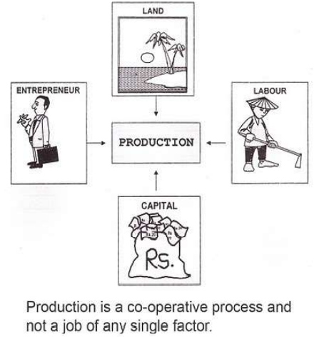
Factors of Production
Anything that assist production is termed as factor of production.
There are Four basic factors of Production, Land, Labour, Capital Entrepreneur.
Land- All the natural resources that are available above or below the surface of the earth is defined as Land.
Labour is human factor of any kind, manual or mental, skilled or unskilled, scientific or artistic undertaken with a view of creating or adding utility.
Capital is a man-made resource of production used to produce further wealth.
Entrepreneur is a person who brings in land, labour & capital in one place & uses it for the production process.

Slide 4
Production Function
It is the Functional relationship between input and output.
The firm’s production function for a particular good (q) shows the maximum amount of the good that can be produced using alternative combinations of capital (K) and labor (L)
Therefore, Q = f(K,L)
It is central to the marginalist focus of neoclassical economics.
There are many types of production function such as Cobb-Douglas production function, Leontief production function, CES production function etc.

Slide 5
Production Function
On the basis of time period the production function can be categorized as:
Short-run Production Function- At least one factor of production is assumed to be fixed.
Long-run Production Function- All factors of production are variable.

Slide 6
COBB-Douglas Production Function
During 1900–1947, Charles Cobb and Paul Douglas formulated and tested the Cobb–Douglas production function through various statistical evidence.
It is a linear homogeneous production function of degree one.
Q= Output
L= Labour
C= Capital
A= Technical Efficiency

Slide 7
Properties
Marginal product of Labour is α/L times total product.
Marginal product of Capital is β/K times total product.
Share of Labour in CD Production function is α times the total product.
Share of Capital in CD Production function is β times the total product.
CD Production function satisfies the Eulers Theorem.
Elasticity of Labour is α, elasticity of Capital is β.

Slide 8
Limitations
There are only two factors of production.
Cobb Douglas production function shows constant returns. But in actual practice such returns are not possible and some what rare. Normally firms are subject to either increasing or diminishing returns.
No single producer raises output for the sake of getting constant returns. The producer aims not at constant returns but at achieving increasing returns.
This production function is not applicable to agriculture.

